Slide 1


FlickZilla
Your Everyday Entertainment Partner
Guidance by :- DHRUVI TRIVEDI MAAM

Slide 2
Created By
21CE143
JAY THANKI
21CE148
PRINCE UPADHYAY
21CE150 AUM VEKARIYA

Slide 3

Table of Contents
01 PROBLEM STATEMENT
02 CURRENT SITUATION
03 PURPOSE OF THE WEBSITE
04 REQUIREMENT
05 WEEKLY OUTCOME
06 References

Slide 4
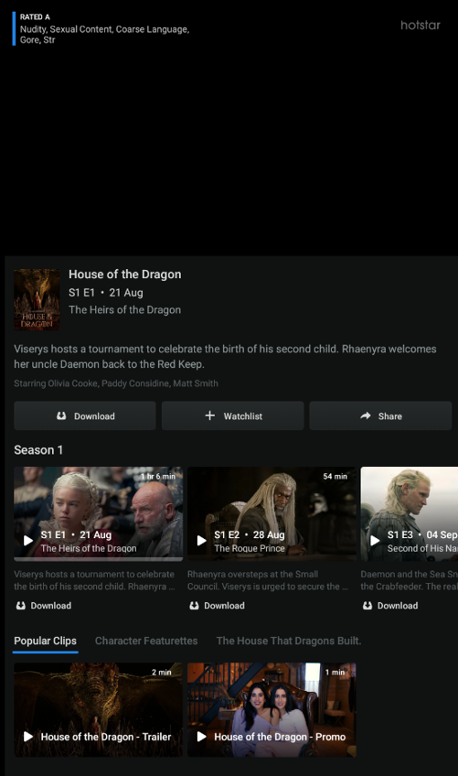
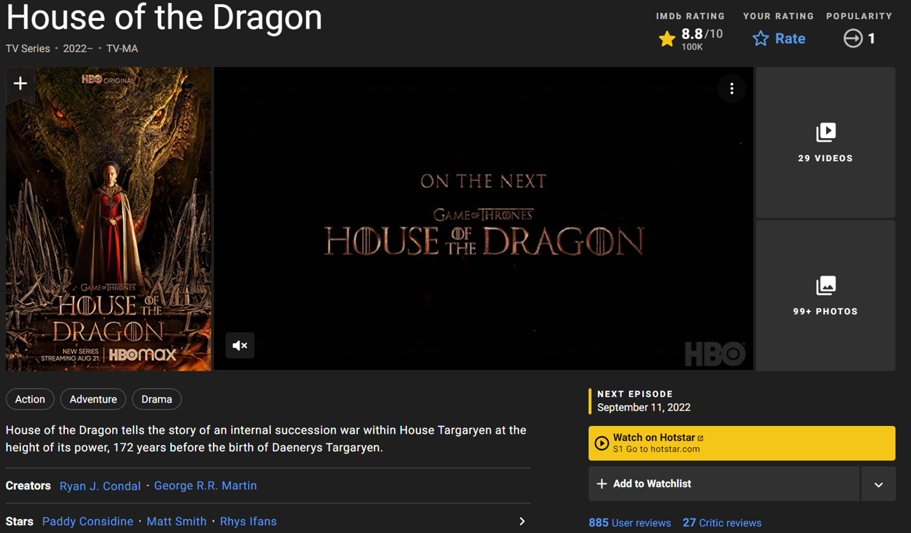
PROBLEM STATEMENT
For watching any movie, you will prefer the movie rating and details of the movie at one site and then go for the actual movie streaming site.
But what if, when you can get both the things at the same place and at low price….
Due to such need of students we have decide to make a Movie streaming Website.

Slide 5

Project Description
It’s a very useful website for trusted movies rating and also to download the movies and series at any time
It is very time saving and useful for the user
And Who doesn’t want to get both the things at the same place ?
.

Slide 6
Why Movie Streaming Website (Cause )
In current scenario the user is going to some sites where they get some trusted rating and then go at the streaming sites where they can watch the movie and web series.
Sometimes it may happen that users is at low interconnective area and they can’t watch movie at good quality and want to watch downloaded movie so we are providing an option for this.
If users are not willing to subscribe on a monthly basis, they can always choose to rent a film per one-time view.
So our website is helpful for both the scenarios.

Slide 7
01
It is fully dynamic website with good user experience
02
It provide a separate interface for rating section and streaming section
03
It provides user to make watchlist of the content and save it
It has very few amount of subscription few
And rented movie system also
04
It provide user the choice to watch regional cinema also
05
FEATURES Of OUR WEBSITE

Slide 8
REQUIREMENTS
Hardware
Laptop :
Windows 7/8/10/11
MacOs
Mobile :
RAM : 2 GB (minimum)
Technology
HTML
CSS
JavaScript
Node Js
Java/C++
Mongo db
Software
VS Code
AnyOS
Browser

Slide 9
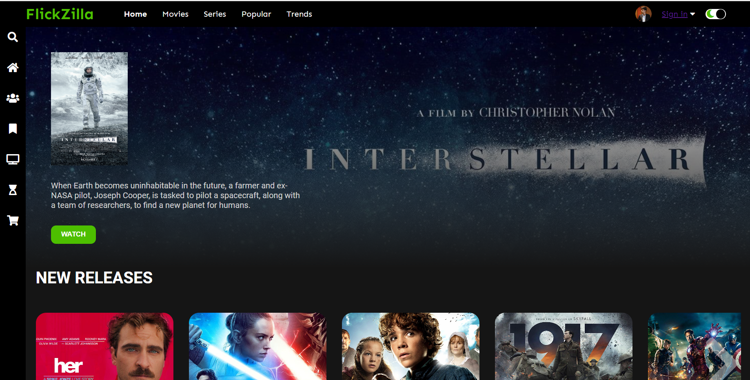
Glimpse of Website (Home Page)

Slide 10
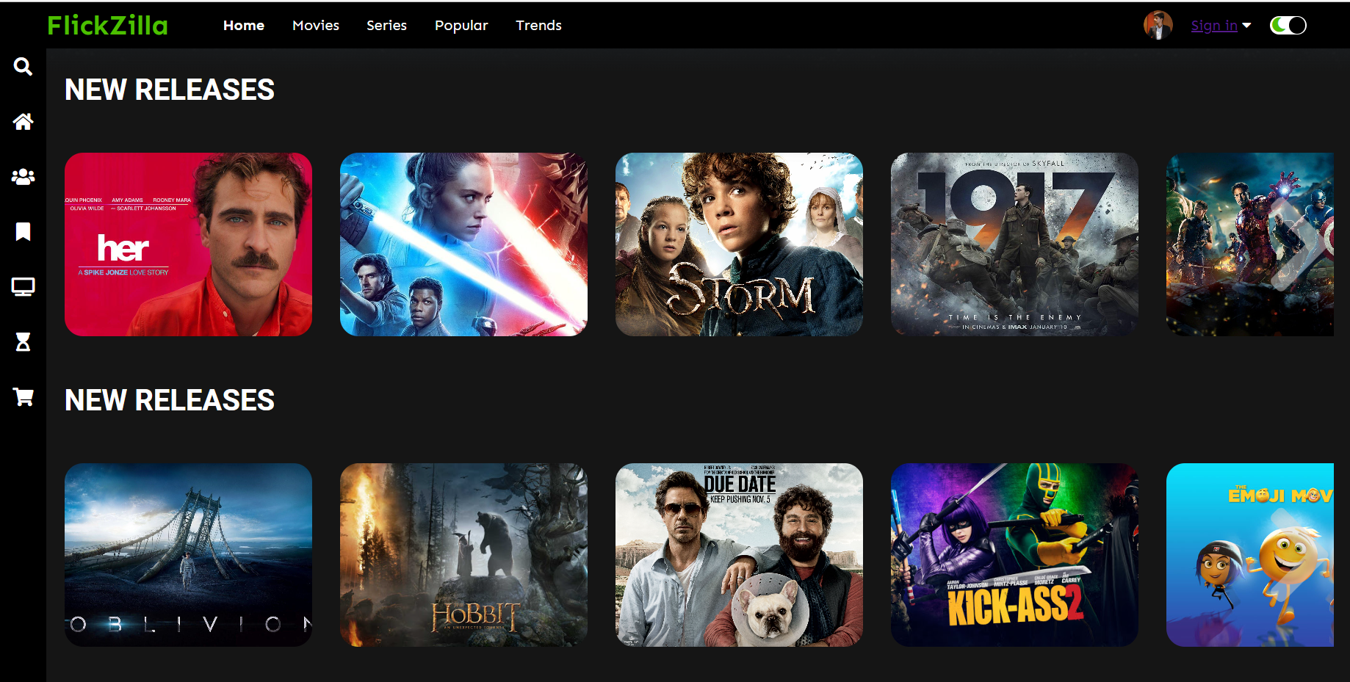
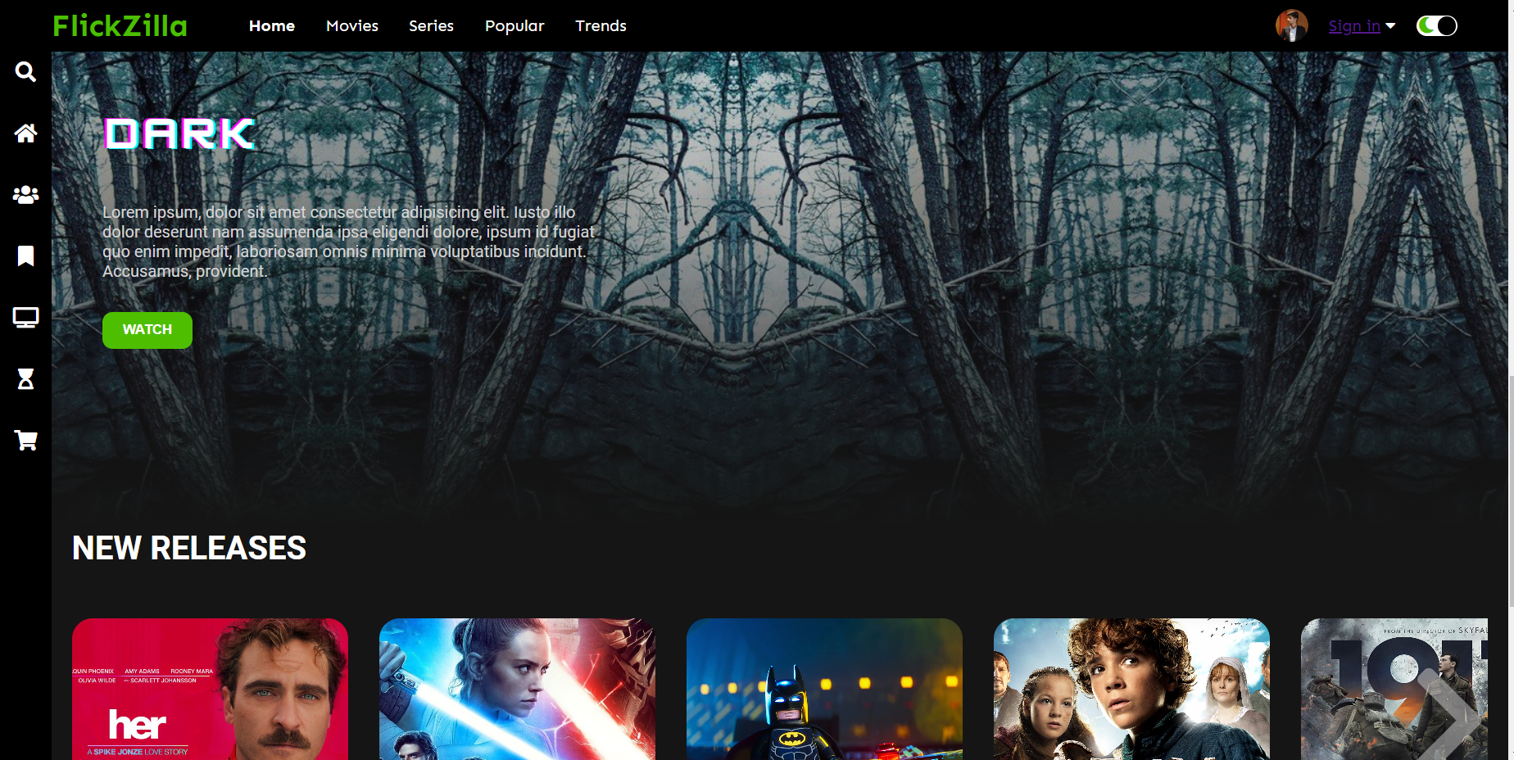
Continue..

Slide 11
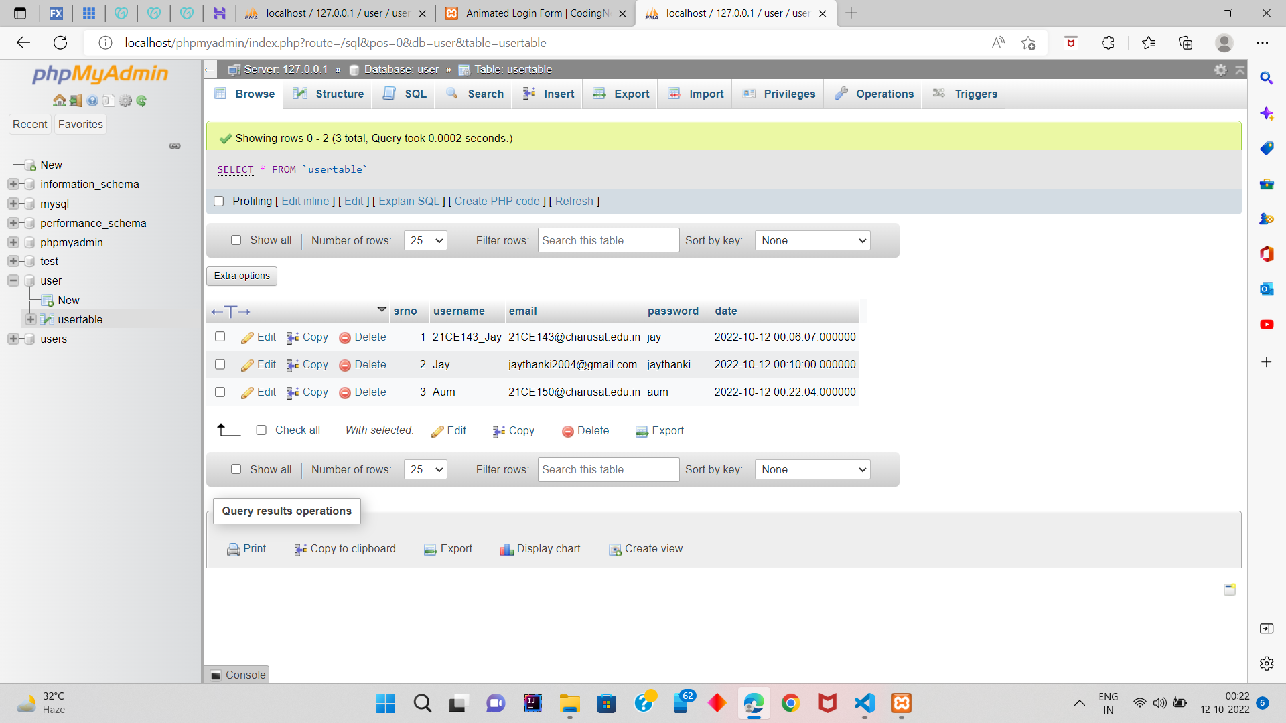
Database

Slide 12
Our Goals
Expansion
Experience
Our goal is to provide thehigh quality of content
Usability
User’s get high quality of resolution and user interactive platform
Can be used easily on either mobile phone or desktop

Slide 13
Team-Work
NOTE:-
Everybody are learning and helping with everything this is just a specialization filled of work
21CE143 -Jay
Backend
GUI(Navigation bar, side bar , Content-container)
PPT
01
02
03
21CE150- Aum Vekariya
GUI(Content-Container )
PPT
21CE148 – Prince Upadhyay
Frontend
( login page, PPT )

Slide 14
Roadmap
Week 1
Gathered information, Exploring and
Week 3
Continue..
Week 5
1
3
5
2
4
6
Week 2
started Frontend
Course
Week 4
Implement some things
Week 6
Started backend course

Slide 15

Future Enhancement
Improving user’s experience
Increasing the reach of the website
Making the application of the same

Slide 16

References
YouTube Tutorials
HTML , CSS :
https://youtube.com/playlist?list=PLu0W_9lII9agiCUZYRsvtGTXdxkzPyItg
JavaScript :
https://youtube.com/playlist?list=PLu0W_9lII9ajyk081To1Cbt2eI5913SsL
ReactJs:
https://www.youtube.com/watch?v=MfhZJcTOy1A&feature=youtu.be
Udemy Full-stack Course
https://www.udemy.com/course/the-complete-web-developer-zero-to-mastery/

Slide 17
THANKS!

